Slide 1
CSE225: Data Structure and Algorithms
Lec 9: QUEUE

Slide 2
Queue
A list
Data items can be added and deleted
Maintains First In First Out (FIFO) order

Slide 3
Specification of QueueType
Structure: | Elements are added to the rear and removed from the front of the queue.
Definitions (provided by user):
MAX_ITEMS | Maximum number of items that might be on the queue.
ItemType | Data type of the items on the queue.
Operations (provided by the ADT):
MakeEmpty
Function | Sets queueto an empty state.
Postcondition | queueis empty.
Boolean IsEmpty
Function | Determines whether the queue is empty.
Precondition | queuehas been initialized.
Postcondition | Returns true if queueis empty and false otherwise.
Boolean IsFull
Function | Determines whether the queue is full.
Precondition | Queue has been initialized.
Postcondition | Returns true if queue is full and false otherwise.

Slide 4
Specification of QueueType
Enqueue(ItemType newItem)
Function | Adds newItem to the rear of the queue.
Precondition | Queue has been initialized.
Postcondition | If (queue is full), FullQueue exception is thrown, else newItem is at rear of queue.
Dequeue(ItemType& item)
Function | Removes front item from the queue and returns it in item.
Precondition | Queue has been initialized.
Postcondition | If (queue is empty), EmptyQueue exception is thrown and item is undefined, else front element has been removed from queue and item is a copy of removed element.

Slide 5
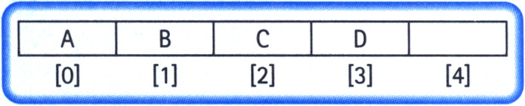
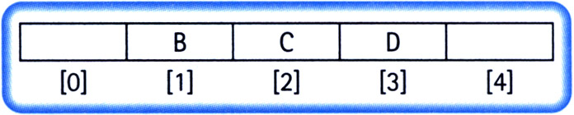
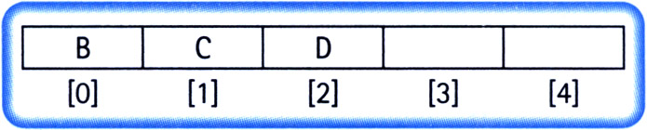
Implementation Issues
Always insert elements at the back of the array.
Complexity of deletion: O(N)

Slide 6
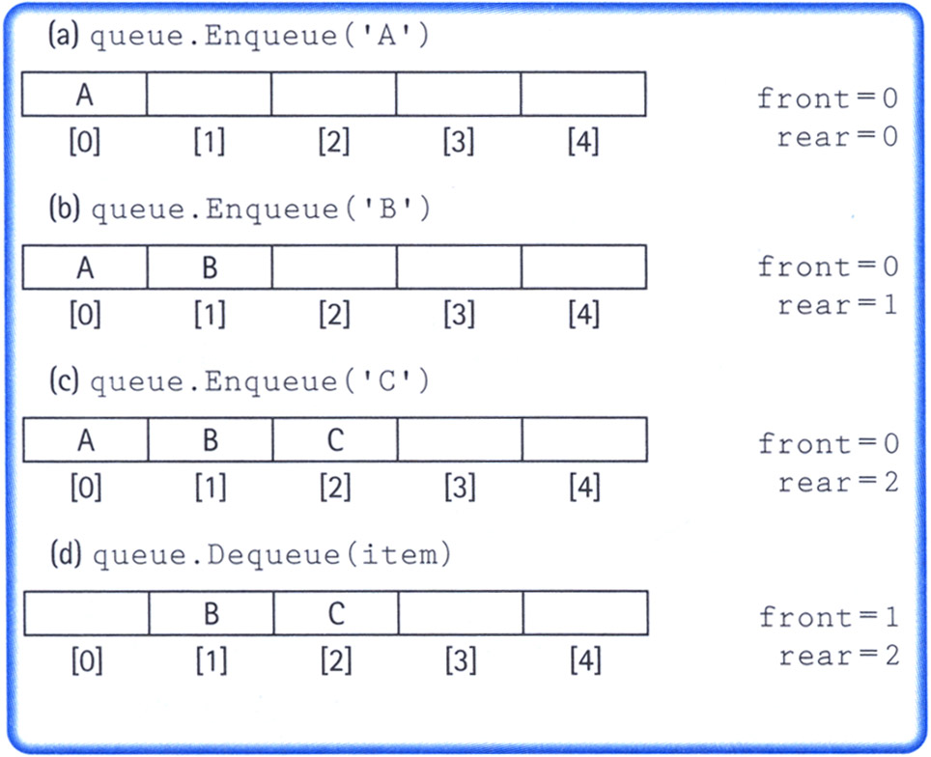
Implementation Issues
Maintain two indices: front and rear
Increment the indices as additions and deletions are performed (rear++ for addition and front++ for deletion)
Dead space

Slide 7
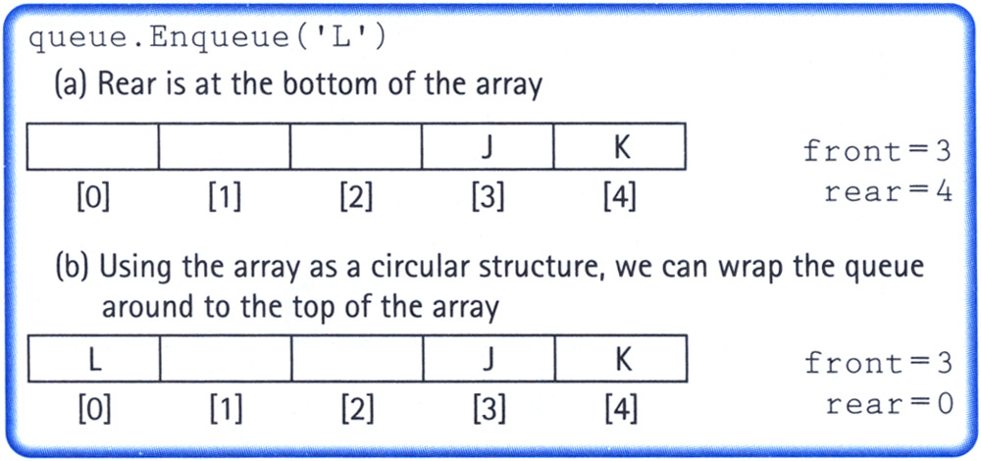
Implementation Issues
Maintain two indices: front and rear
Make the indices “wrap around” when they reach the end of the array
rear = (rear + 1) % maxQue; //maxQue=size of array
front = (front + 1) % maxQue;

Slide 8
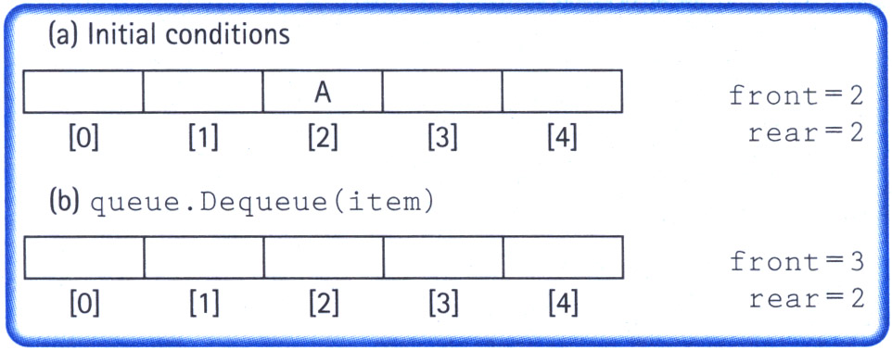
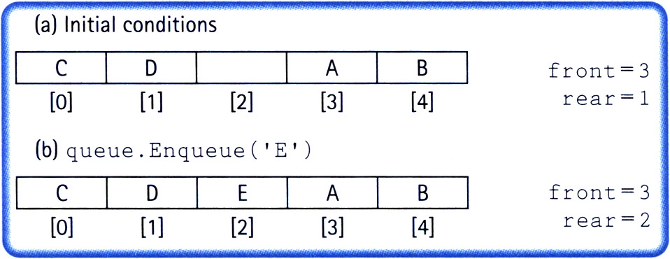
Implementation Issues
How do we differentiate between the empty state and the full state?

Slide 9
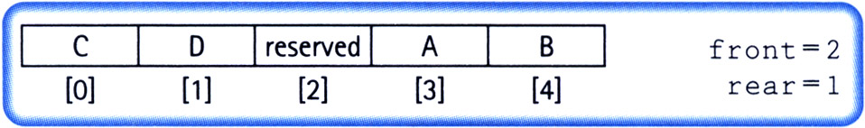
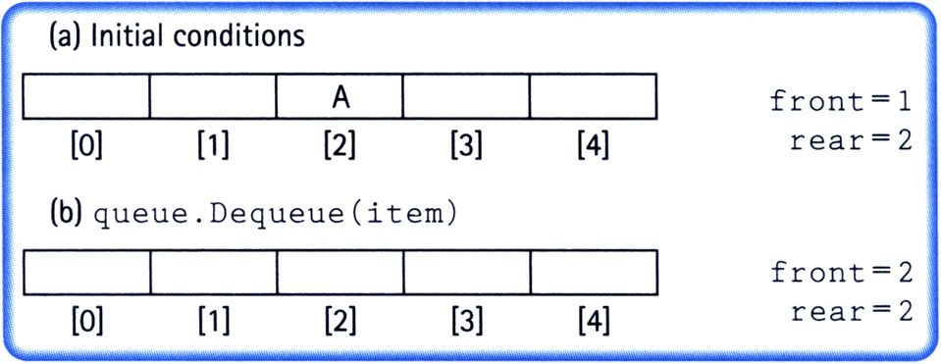
Implementation Issues
Let front indicate the index of the array slot preceding the front element.
The array slot preceding the front element is reserved and items are not assigned in that slot.

Slide 10
Implementation Issues
Full queue when (rear + 1) % maxQue == front
Empty queue when front == rear

Slide 11
queuetype.h
typedef char ItemType;
class FullQueue
{};
class EmptyQueue
{};
class QueType
{
public:
QueType();
QueType(int max);
~QueType();
void MakeEmpty();
bool IsEmpty();
bool IsFull();
void Enqueue(ItemType newItem);
void Dequeue(ItemType& item);
private:
int front;
int rear;
ItemType* items;
int maxQue;
};

Slide 12
queuetype.cpp
#include "QueType.h"
QueType::QueType(int max)
{
maxQue = max + 1;
front = maxQue - 1;
rear = maxQue - 1;
items = new ItemType[maxQue];
}
QueType::QueType()
{
maxQue = 501;
front = maxQue - 1;
rear = maxQue - 1;
items = new ItemType[maxQue];
}
QueType::~QueType()
{
delete [] items;
}
void QueType::MakeEmpty()
{
front = maxQue - 1;
rear = maxQue - 1;
}
bool QueType::IsEmpty()
{
return (rear == front);
}
bool QueType::IsFull()
{
return ((rear+1)%maxQue == front);
}

Slide 13
queuetype.cpp
void QueType::Enqueue(ItemType newItem)
{
if (IsFull())
throw FullQueue();
else
{
rear = (rear +1) % maxQue;
items[rear] = newItem;
}
}
void QueType::Dequeue(ItemType& item)
{
if (IsEmpty())
throw EmptyQueue();
else
{
front = (front + 1) % maxQue;
item = items[front];
}
}

Slide 14
queuetype.cpp
#include "QueType.h"
QueType::QueType(int max)
{
maxQue = max + 1;
front = maxQue - 1;
rear = maxQue - 1;
items = new ItemType[maxQue];
}
QueType::QueType()
{
maxQue = 501;
front = maxQue - 1;
rear = maxQue - 1;
items = new ItemType[maxQue];
}
QueType::~QueType()
{
delete [] items;
}
void QueType::MakeEmpty()
{
front = maxQue - 1;
rear = maxQue - 1;
}
bool QueType::IsEmpty()
{
return (rear == front);
}
bool QueType::IsFull()
{
return ((rear+1)%maxQue == front);
}
O(1)
O(1)
O(1)
O(1)
O(1)
O(1)

Slide 15
queuetype.cpp
void QueType::Enqueue(ItemType newItem)
{
if (IsFull())
throw FullQueue();
else
{
rear = (rear +1) % maxQue;
items[rear] = newItem;
}
}
void QueType::Dequeue(ItemType& item)
{
if (IsEmpty())
throw EmptyQueue();
else
{
front = (front + 1) % maxQue;
item = items[front];
}
}
O(1)
O(1)

Slide 16
Applications of Queue Data Structure
Queue is used when things don’t have to be processed immediately, but have to be processed in First In First Out order like Breadth First Search. This property of Queue makes it also useful in following kind of scenarios.
When a resource is shared among multiple consumers. Examples include CPU scheduling, Disk Scheduling.
When data is transferred asynchronously (data not necessarily received at same rate as sent) between two processes. Examples include IO Buffers, pipes, file IO, etc.)

Slide 18
Dynamic ADT QUEUE
A queue can be implemented for
Abstract data type (using template)
Dynamic sizing (using pointers)
the slides next present the implementation code

Slide 19
Queue ADT Operations
MakeEmpty -- Sets queue to an empty state.
IsEmpty -- Determines whether the queue is currently empty.
IsFull -- Determines whether the queue is currently full.
Enqueue (ItemType newItem) -- Adds newItem to the rear of the queue.
Dequeue (ItemType& item) -- Removes the item at the front of the queue and returns it in item.
19

Slide 20
ADT Queue Operations
Transformers
MakeEmpty
Enqueue
Dequeue
Observers
IsEmpty
IsFull
change state
observe state
20

Slide 21
DYNAMIC ARRAY IMPLEMENTATION
class QueType
QueType
Private Data:
front 1
rear 4
maxQue 5
items
~QueType
Enqueue
RESERVED
‘C’ ‘X’ ‘J’
Dequeue
.
.
.
items [0] [1] [2] [3] [4]

Slide 22
//--------------------------------------------------------
// CLASS TEMPLATE DEFINITION FOR CIRCULAR QUEUE
#include "ItemType.h" // for ItemType
template<class ItemType>
class QueType {
public:
QueType( );
QueType( int max ); // PARAMETERIZED CONSTRUCTOR
~QueType( ) ; // DESTRUCTOR
. . .
bool IsFull( ) const;
void Enqueue( ItemType item );
void Dequeue( ItemType& item );
private:
int front;
int rear;
int maxQue;
ItemType* items; // DYNAMIC ARRAY IMPLEMENTATION
};
22

Slide 23
//--------------------------------------------------------
// CLASS TEMPLATE DEFINITION FOR CIRCULAR QUEUE cont’d
//--------------------------------------------------------
template<class ItemType>
QueType<ItemType>::QueType( int max ) // PARAMETERIZED
{
maxQue = max + 1;
front = maxQue - 1;
rear = maxQue - 1;
items = new ItemType[maxQue]; // dynamically allocates
}
template<class ItemType>
bool QueType<ItemType>::IsEmpty( )
{
return ( rear == front )
}
23

Slide 24
//--------------------------------------------------------
// CLASS TEMPLATE DEFINITION FOR CIRCULAR QUEUE cont’d
//--------------------------------------------------------
template<class ItemType>
QueType<ItemType>::~QueType( )
{
delete [ ] items; // deallocates array
}
.
.
.
template<class ItemType>
bool QueType<ItemType>::IsFull( )
{ // WRAP AROUND
return ( (rear + 1) % maxQue == front )
}
24

